Slide 1
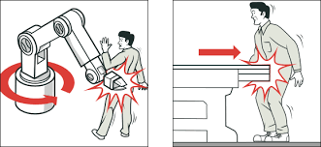
Module 4
SAFETY HAZARDS IN MACHINES

Slide 2
Syllabus
Machinery safeguard-Point-of-Operation, Principle of machine guarding -types of guards and devices.
Safety in turning and grinding. Welding and Cutting-
Safety Precautions of Gas welding and Arc Welding
Material Handling-Classification-safety consideration- manual and mechanical handling. Handling assessments and techniques- lifting, carrying, pulling, pushing, palletizing and stocking.
Material Handling equipment-operation & maintenance. Maintenance of common elements-wire rope, chains slings, hooks, clamps.
Hearing Conservation Program in Production industries.

Slide 3
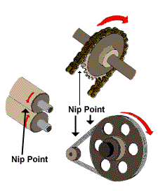
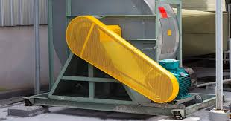
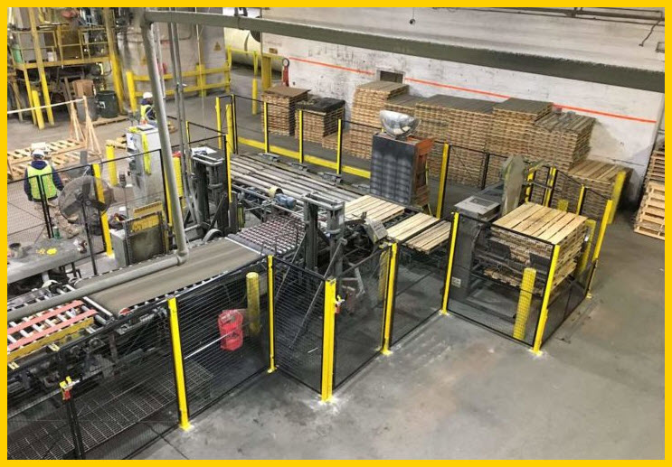
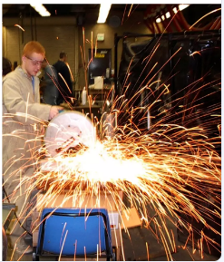
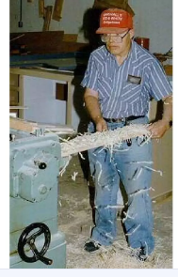
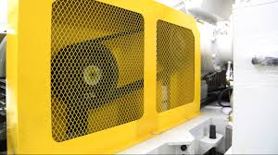
MACHINERY SAFEGUARD
Machine guards are the first line of defense against injuries caused by machine operation.
Each machine must have adequate safeguards to protect operators and other employees in the immediate work area from hazards created by ingoing nip points, rotating parts, sparks and flying debris

Slide 4
Principle of Machine Guarding
Prevent contact : The safeguard must prevent hands, arms, and any other part of a worker’s body from making contact with dangerous moving parts
Secure : Guards and safety devices should be made of durable material that will withstand the conditions of normal use. They must be firmly secured to the machine
Protect from falling objects : Safeguard should ensure that no objects can fall into moving parts. A small tool which is dropped into a cycling machine could easily become a projectile that could strike and injure someone

Slide 5
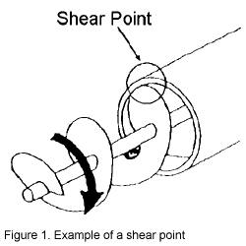
Principle of Machine Guarding
Create no new hazard : A safeguard defeats its own purpose if it creates a hazard of its own such as a shear point, a jagged edge, or an unfinished surface which can cause a laceration. The edges of guards, for instance, should be rolled or bolted in such a way that they eliminate sharp edges. Machine guards should not obstruct the operator’s view
Not interfere with the machine operation : Any safeguard which impedes a worker from performing the job quickly and comfortably might soon be overridden or disregarded. Proper safeguarding can actually enhance efficiency since it can relieve the worker’s apprehensions about injury.

Slide 6
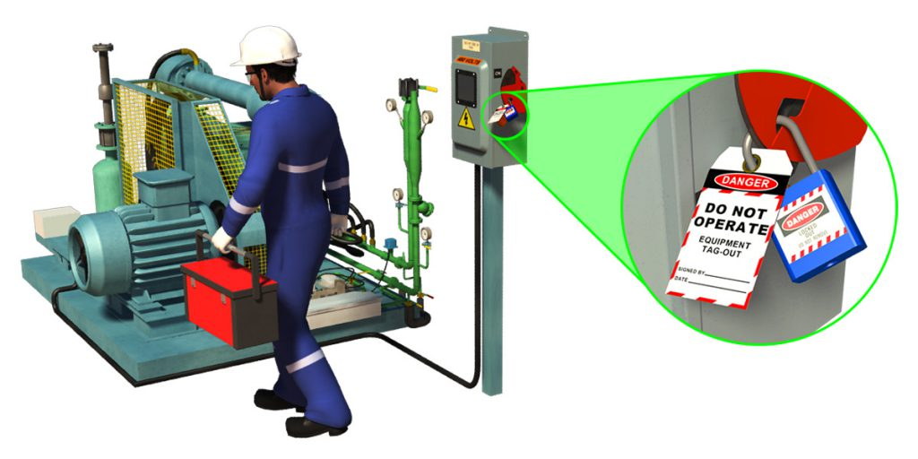
Principle of Machine Guarding
6. Allow safe lubrication
If possible, one should be able to lubricate the machine without removing safeguards.
Locating oil reservoirs outside the guard, with a line leading to the lubrication point, will reduce the need for the operator or maintenance worker to enter the hazardous area.

Slide 7
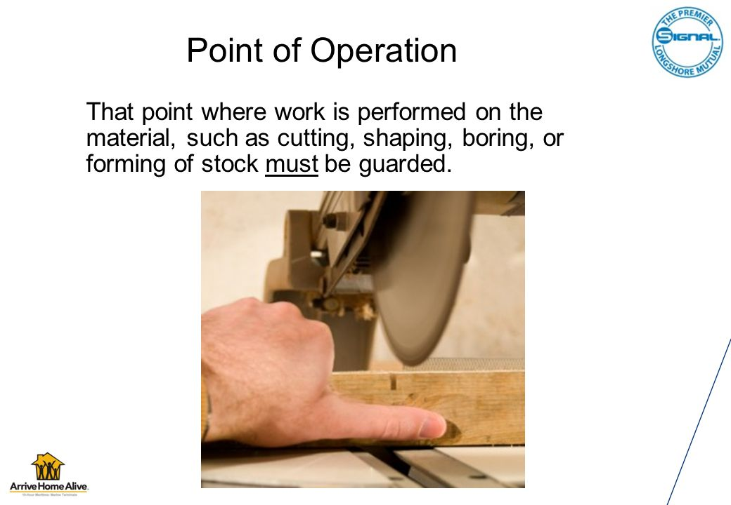
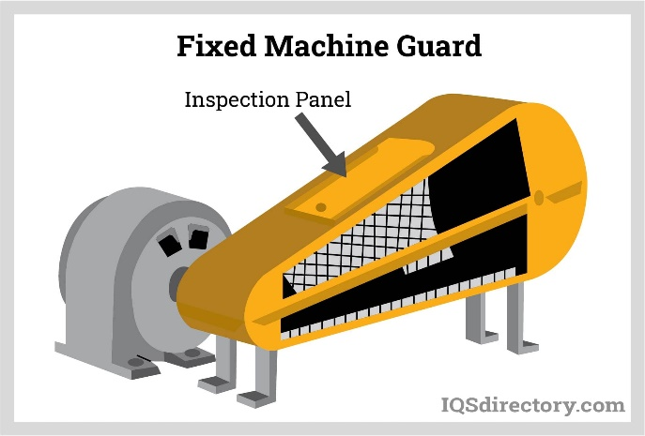
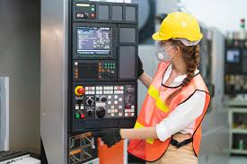
Machine Guarding at the Point of Operation
All machines consist of three fundamental areas: the point of operation, the power transmission device, and the operating controls
The point of operation is where work is performed on the material, such as cutting, shaping, boring, or forming of stock
The power transmission apparatus is all components of the mechanical system which transmit energy to the part of the machine performing the work. These components include flywheels, pulleys, belts, connecting rods, couplings, cams, spindles, chains, cranks, and gears
A mechanical or electrical power control shall be provided on each machine to make it possible for the operator to cut off the power from each machine without leaving his position at the point of operation

Slide 8
Machine operators often need to come into close proximity to points of operation in the course of their work
In those cases, machine guards can be installed to prevent hands or other body parts from accidentally getting caught in those moving parts
When a solid guard would impede the operator’s productivity or cannot be installed, optical sensing technologies such as safety light curtains can act as a safeguard at the point of operation

Slide 9
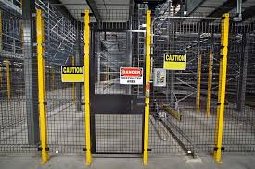
METHODS OF SAFEGUARDING
There are five (5) general types of machine safeguards that can be used to protect workers and personnel in the immediate vicinity of machinery. They are:
Guards :
These are physical barriers that prevent contact.
They can be fixed, interlocked, adjustable, or self-adjusting.
Can be made of various materials, such as metal, plastic, or wood, and are typically attached to the machine using screws, brackets or clamps
Common guard types: door guards, gate guards, and fence guards
Must be properly installed and maintained to be effective

Slide 10
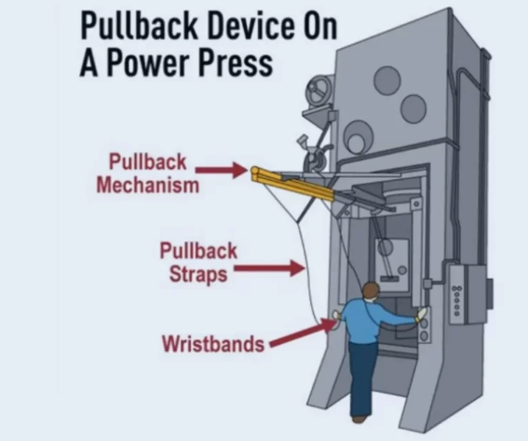
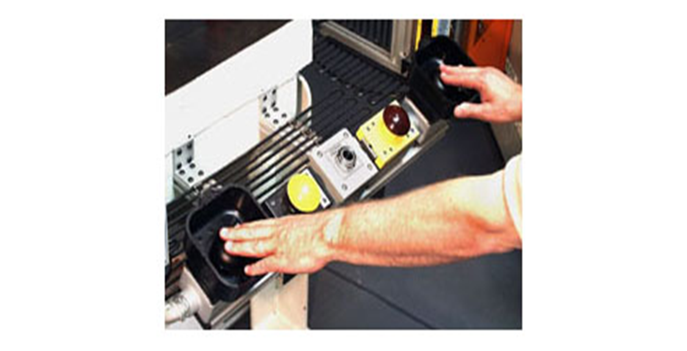
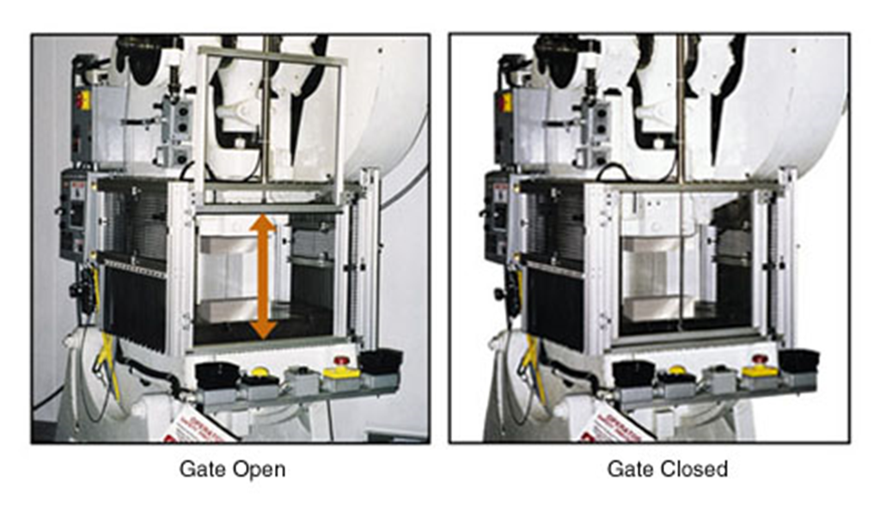
Devices :
These limit or prevent access to the hazardous area.
It may stop the machine if a hand or any part of the body is inadvertently placed in the danger area
Restrain or withdraw the operator’s hands from the danger area during operation
Require the operator to use both hands on machine controls, thus keeping both hands and body out of danger
Provide a barrier which is synchronized with the operating cycle of the machine to prevent entry to the danger area during the hazardous part of the cycle

Slide 11
Automated Feeding and Ejection Mechanisms :
These eliminate the operator’s exposure to the point of operation while handling stock (materials).

Slide 12
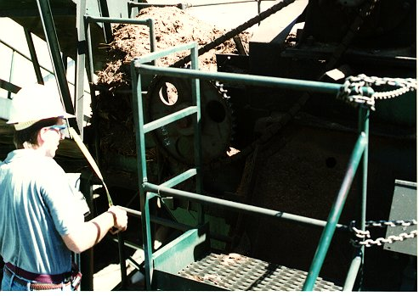
Machine Location or Distance :
This method removes the hazard from the operator’s work area. This may be accomplished by locating a machine so that the hazardous parts of the machine are located away from operator work stations or other areas where employees walk or work

Slide 13
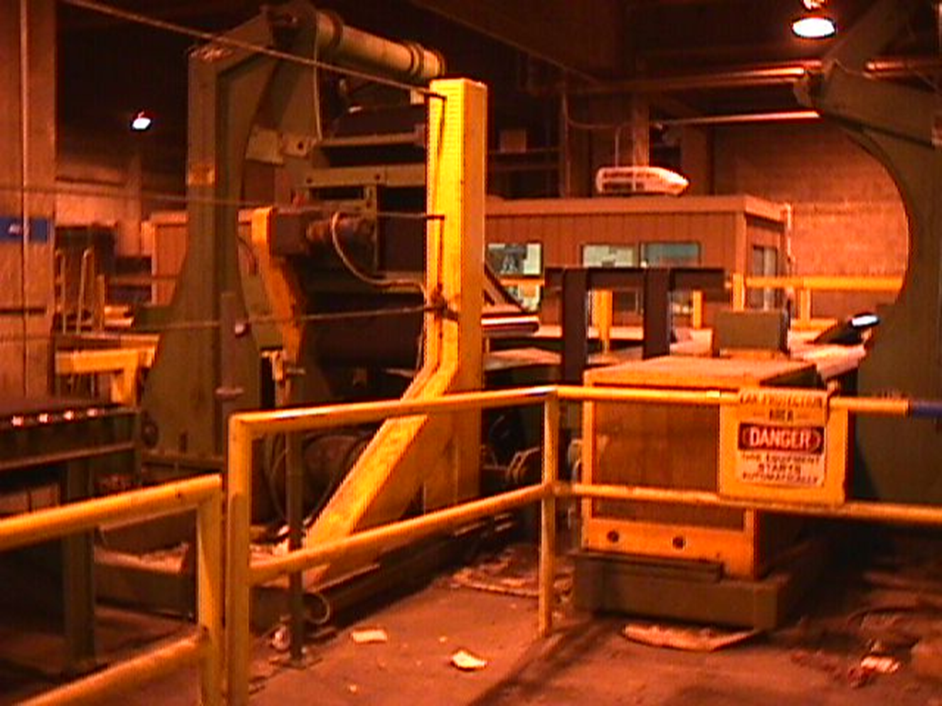
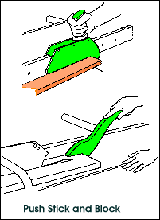
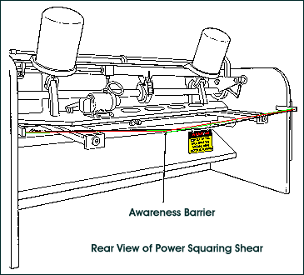
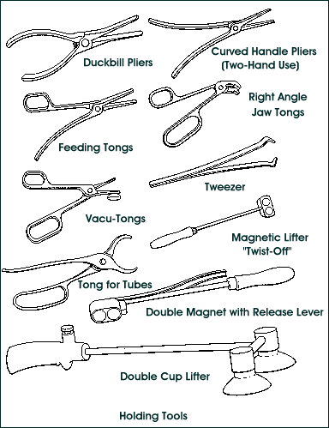
Miscellaneous Aids :
These methods can be used to protect both operators and people in the immediate vicinity of operating machinery. Examples include shields to contain chips, sparks, sprays or other forms of flying debris; holding tools that an operator can use to handle materials going into the point of operation; and awareness barriers to warn people about hazards in the area.

Slide 14
MACHINE SAFEGUARD DEVICES
A safety device limit or prevent access to the hazardous area. These can be presence-sensing devices, pullback or restraint straps, safety trip controls, two-hand controls, or gates.
Types:
Presence-Sensing Devices
Pullback Devices
Restraint Devices
Safety Trip Controls
Two-hand control Device
Two-Hand Trip Devices

Slide 15
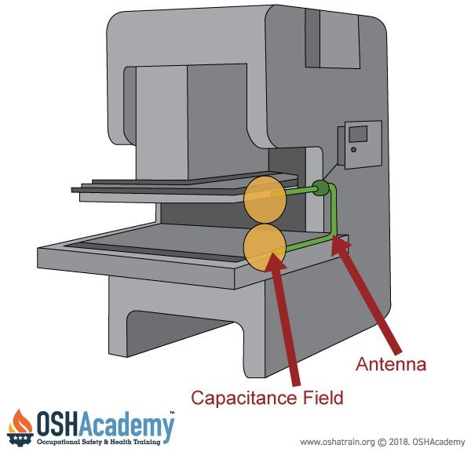
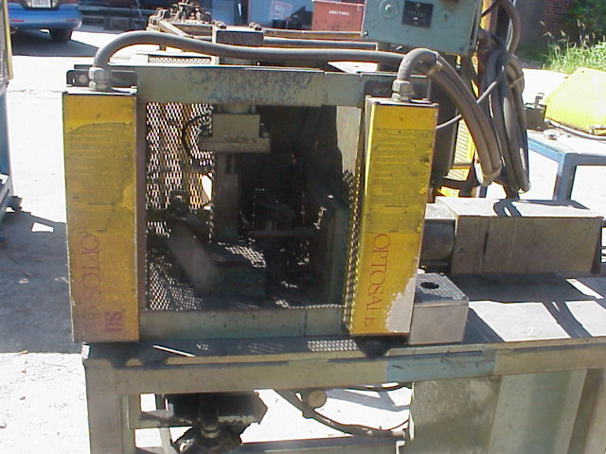
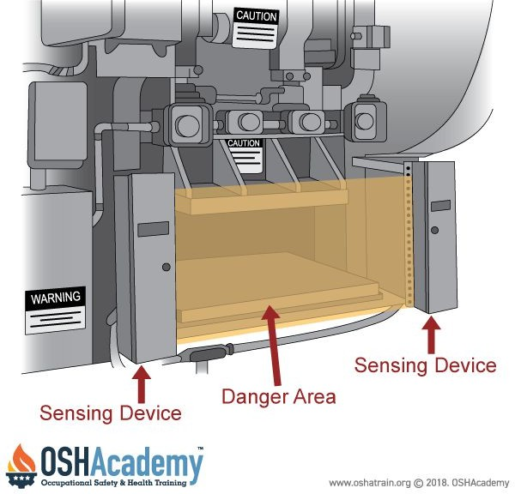
1. Presence-Sensing Devices
These devices use a system of light or radiofrequency sources and controls, which can interrupt the machine’s operating cycle if the light or electric field is broken, the machine stops and will not cycle
i. Photoelectric presence-sensing device: When the light beam is broken, either the ram will not start to cycle, or, if the cycle has begun, the stopping mechanism will be activated so that the press stops before the operator’s hand can enter the danger zone.

Slide 16
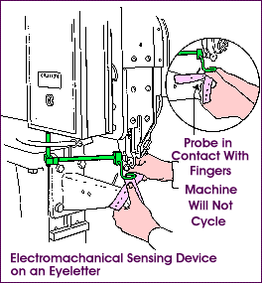
1. Presence-Sensing Devices
ii. Electromechanical sensing device: This device has a probe or contact bar which descends to a predetermined distance when the operator initiates the machine cycle. If an obstruction prevents it from descending its full predetermined distance, the control circuit does not actuate the machine cycle.

Slide 17
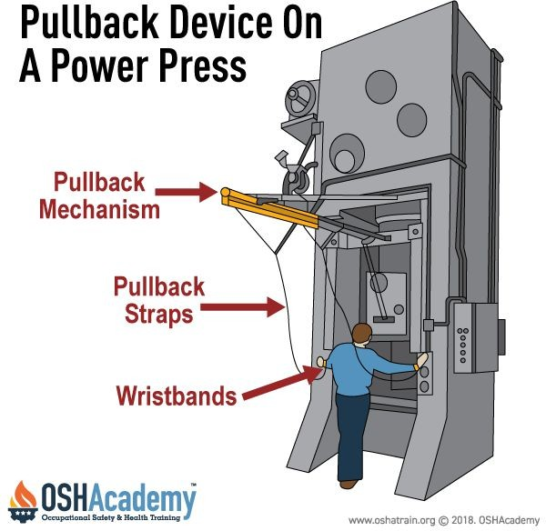
2. Pullback Devices
Pullback attached
devices use a series of to the operator’s hands,
cables wrists,
and/or arms. This type of device is primarily used on machines with stroking action.
When the slide/ram is up between cycles, the operator is allowed access to the point of operation.
When the slide/ram begins to cycle by starting its descent, a mechanical linkage automatically assures the withdrawal of the hands from the point of operation.

Slide 18
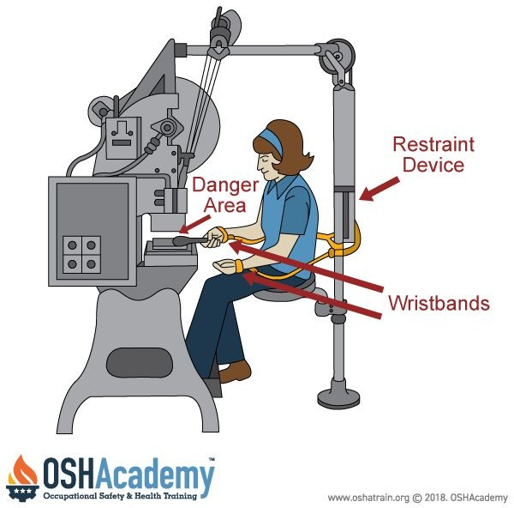
3. Restraint Devices
The restraint (holdout) device in the figure to the right uses cables or straps attached to the operator’s hands at a fixed point.
The cables or straps must be adjusted to let the operator’s hands travel only within a predetermined safe area.
There is no extending or retracting action is required because the hands are never allowed to extend into the danger area.
Consequently, hand-feeding tools are often necessary if the operation involves placing material in a dangerous area.

Slide 19
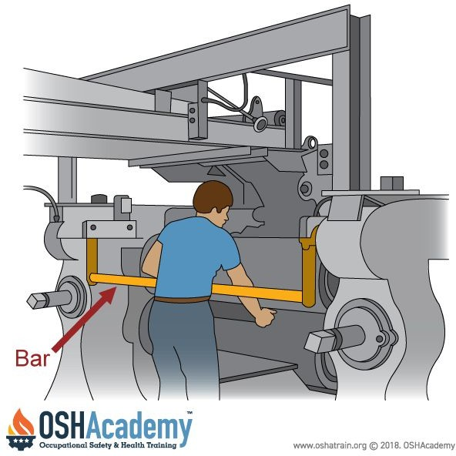
4. Safety Trip Controls
Safety trip controls provide a quick means for deactivating the machine in an emergency. A pressure-sensitive body bar, when depressed, will deactivate the machine. If the operator or anyone trips, loses balance, or is drawn toward the machine, applying pressure to the bar will stop the operation. The positioning of the bar, therefore, is critical. It must stop the machine before a part of the employee’s body reaches the dangerous area.
Unfortunately, it may be easy to defeat the body bar by going under it into the danger zone. The figure here shows a pressure-sensitive body bar on the front of a rubber mill.

Slide 20
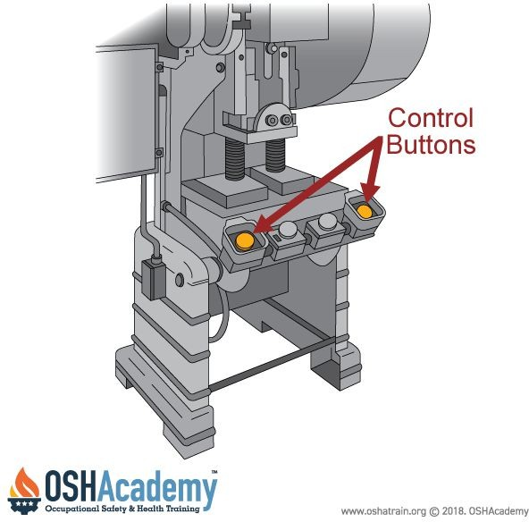
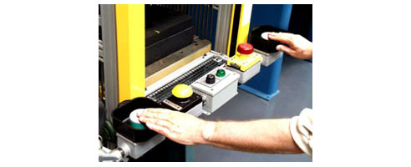
5. Two-Hand Control Devices
The two-hand control device requires constant, concurrent pressure by the operator to activate the machine. This kind of control requires a part- revolution clutch, brake, and a brake monitor if used on a power press. With this type of device, the operator’s hands must be at a safe location (on control buttons) and at a safe distance from the danger area while the machine completes its closing cycle.

Slide 21
6. Two-Hand Trip Devices
The two-hand trip device requires concurrent application of the operator’s control buttons to activate the machine cycle, after which the hands are free. This device requires the joint operation of two trigger buttons located away from the “danger zone” of the press. To be effective, both two-hand controls and trips must be located so that the operator cannot use two hands or one hand and another part of his/her body to trip the machine.

Slide 22
TYPES OF GUARDS
There are four general types of guards
Fixed
Interlocked
Adjustable
Self-adjusting

Slide 23
1. Fixed
Fixed guards are permanently attached to the machine or tool, don’t have any moving parts, and can’t be moved while the machine is in use. They’re most often used to enclose the point of operation, or other hazards that the operator doesn’t need to interact with, like fan blades or flywheels. Because
fixed guards are permanent features of
the machine, they must be any kind of adjustment or
disassembled and removed to perform maintenance.
It may be constructed of sheet metal, screen, wire cloth, bars, plastic, or any other material that is substantial enough to withstand whatever impact it may receive and to endure prolonged use. This guard is usually preferable to all other types because of its relative simplicity and permanence

Slide 24
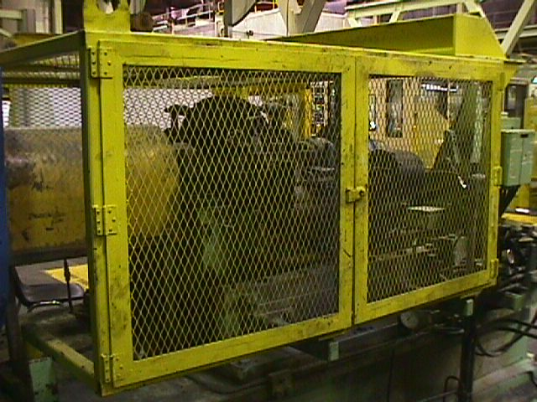
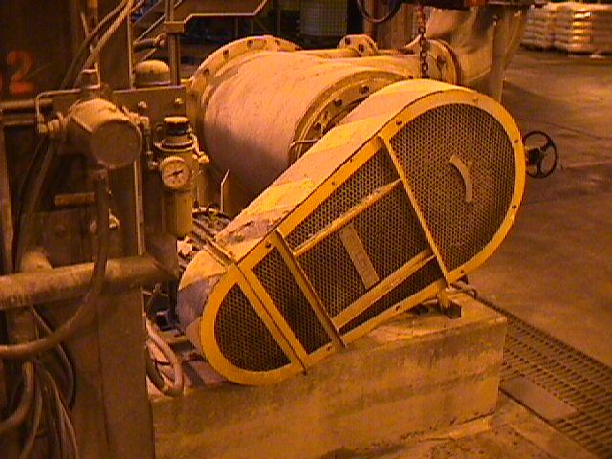
Safeguarding Action
Provides a barrier
Advantages
Can be constructed to suit many specific applications
In-plant construction is often possible
Can provide maximum protection
Usually requires minimum maintenance
Can be suitable to high production, repetitive operations

Slide 25
Disadvantages
May interfere with visibility
Can be limited to specific operations
Machine adjustment and repair often require its removal, thereby necessitating other means of protection for maintenance personnel

Slide 26
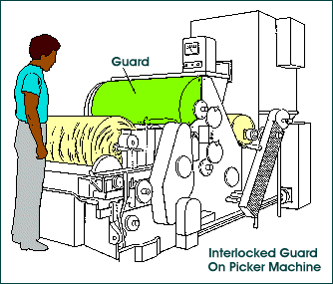
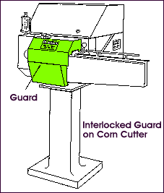
2. Interlocked
Interlocking guards, also known as barrier guards, automatically shut off or disengage the power source when the guard is open or removed. These are particularly useful in situations where operators need to be able to open the guard or access the guarded parts of the machine, such as when clearing jams. These guards allow safe access to interior parts of the machine without requiring a total disassembly. However, they can be easy to open on accident and require careful adjustment and maintenance.
Safeguarding Action
Shuts off or disengages power, stops the moving parts and prevents starting of the machine when the guard is open; should require the machine to be stopped before the worker can reach into the danger area

Slide 27
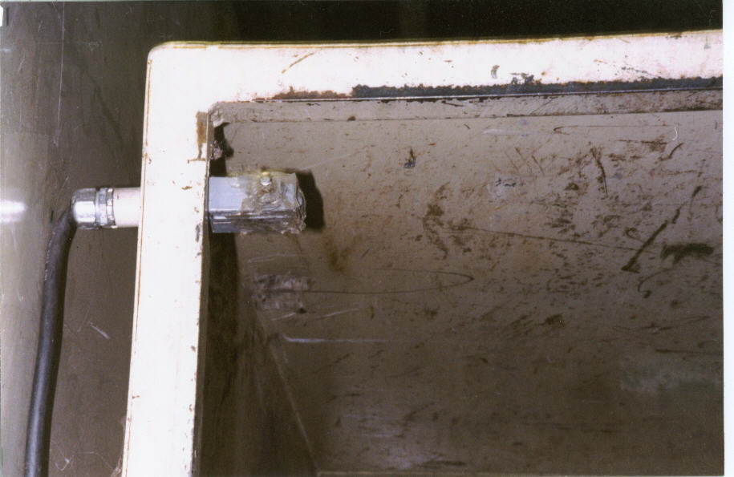
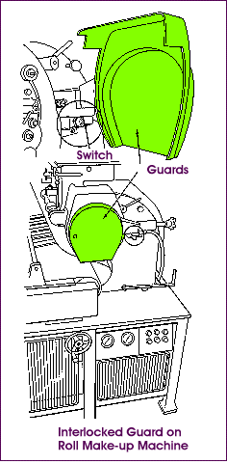
Advantages
Can provide maximum protection
Allows access to the machine for removing jams without time consuming removal of the fixed guards
Disadvantages
Requires careful adjustment and maintenance
May be easy to disengage

Slide 28
3. Adjustable
Adjustable guards, like fixed guards, are permanent, but they can be adjusted to allow the machine to handle different sizes of material. They must be manually adjusted and locked into place, so all employees who will operate adjustable guards must be trained on their use. If improperly adjusted or locked, adjustable guards can fail to prevent contact with moving parts, causing serious or even fatal injury.
Safeguarding Action
Provides a barrier that may be adjusted to facilitate a variety of production operations

Slide 29
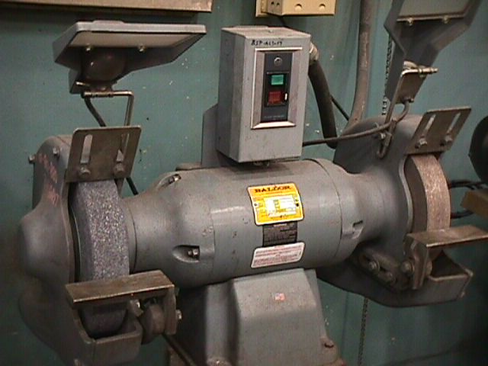
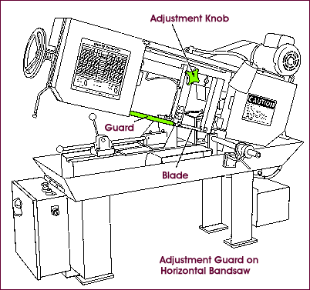
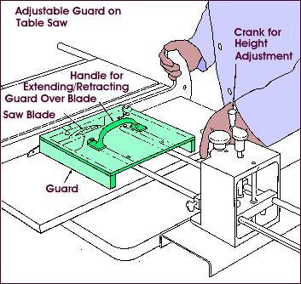
Advantages
Can be constructed to suit many specific applications
Can be adjusted to admit varying sizes of stock
Disadvantages
Hands may enter danger area - protection may not be complete at all times
May require frequent maintenance and/or adjustment
The guard may be made ineffective by the operator
May interfere with visibility

Slide 30
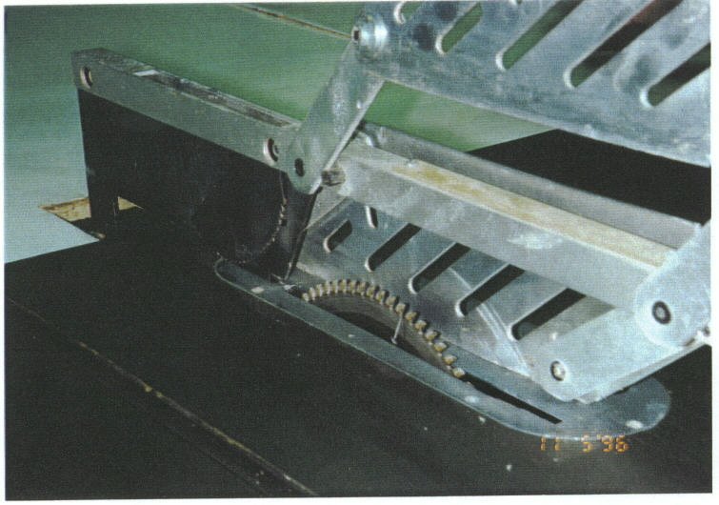
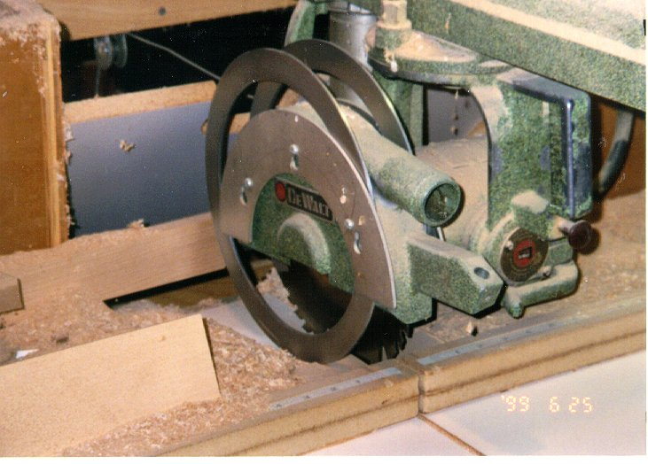
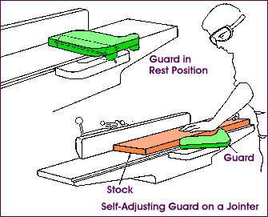
4. Self-adjusting
Self-adjusting guards serve the same purpose as adjustable guards, but automatically adapt to the size of the material. When the machine is at rest, these guards sit all the way down. When the machine is in use, the operator feeds material into the machine, which opens the guard just enough to let the material in. These guards are commonly found on table saws and woodworking tools.
Safeguarding Action
Provides a barrier that moves according to the size of the stock entering the danger area

Slide 31
Advantages
Off-the-shelf guards( available as a stock item) are often commercially available
Disadvantages
Does not always provide maximum protection
May interfere with visibility
May require frequent maintenance and adjustment

Slide 32
SAFETY IN TURNING

Slide 33
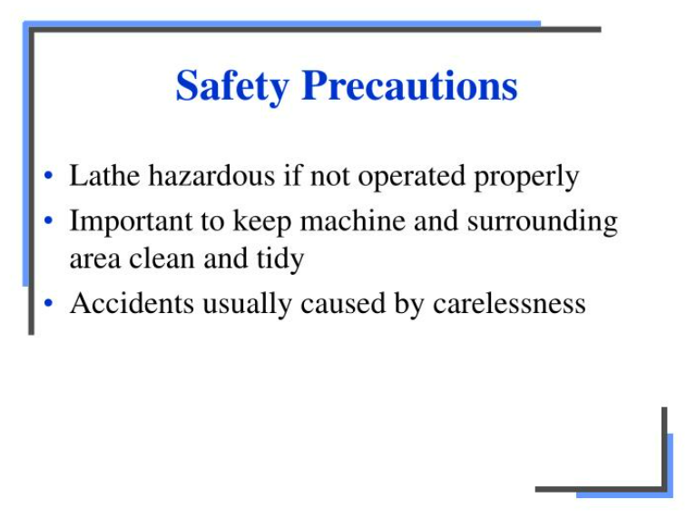
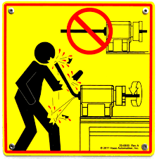

Slide 34
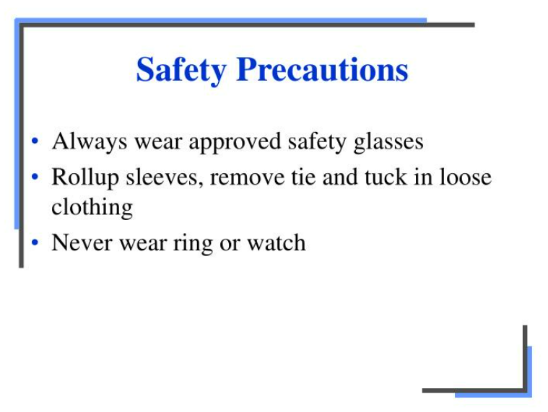
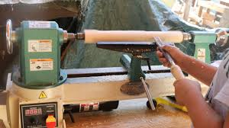

Slide 35
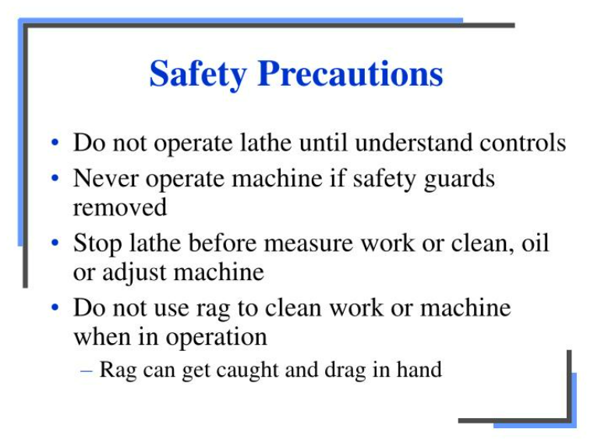
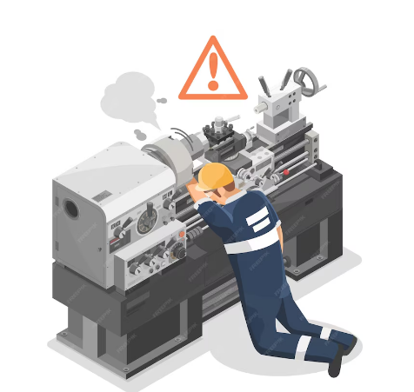

Slide 36
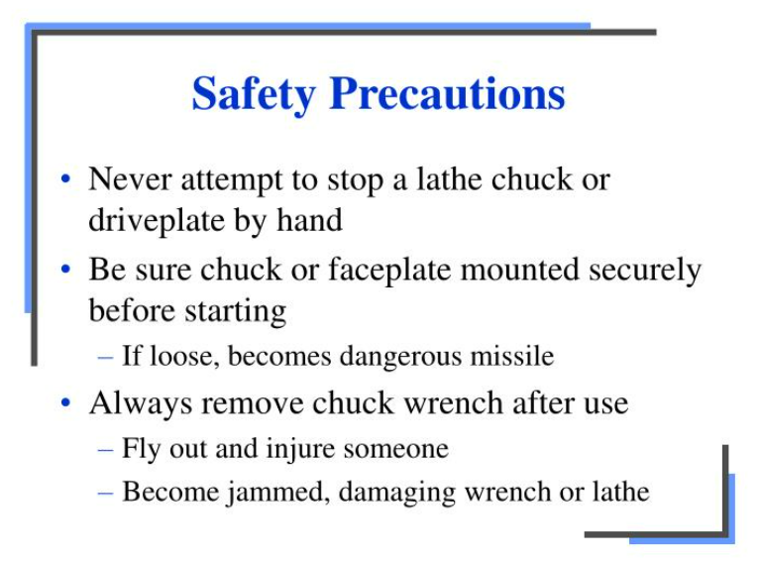
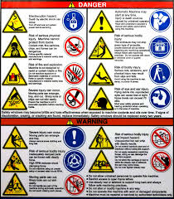

Slide 37



Slide 38



Slide 39

SAFETY PRECAUTIONS WHEN DEALING WITH BORING
Handling boring mills is a complex job that requires specialist precaution aimed at protecting yourself, your colleagues, and your staff from bodily injuries.
Use the right tool for the right job
One of the primary causes of industrial injuries is broken drilling heads. By having the right tooling edge matched with the right operational spindle speed for the right work piece, the chances of industrial accidents are greatly reduced

Slide 40
Always have protective clothing
There is a need to have the right protective gear on. This minimizes the chances of industrial accidents, since your body is always covered in the right clothing.
For a safer operational environment, the clothing used should be tight enough to protect you from having loose hangings that can be easily trapped in the revolving mill parts. Protective optical ware should also be used at all times to protect your eyes from exposure to work piece off-cuts.
Know your machine
Having proper technical knowhow about your machine gives you a competitive edge in increasing your safety.
In fact, less experienced boring machine users have been proven to be thrice as likely as their experienced peers to cause machine-related accidents.
Therefore, only personnel with the right skills should be granted the green light to work with the boring mills.

Slide 41
Service your machines regularly
Regular repairing and servicing of your boring tools give them a precise way of delivering on your expectations.
It also safeguards your company from technical breakdowns resulting from poorly maintained boring tools.

Slide 42
SAFETY IN MILLING

Slide 43


Slide 44



Slide 45



Slide 46



Slide 47

Safety in Grinding Machines

Slide 48


Slide 49


Slide 50


Slide 51


Slide 52


Slide 53


Slide 54

Safety in Gas Welding

Slide 55

Most farms and small shops have some type of equipment for welding and cutting metals.
Acetylene is the most commonly used fuel gas. Acetylene is very flammable and hazardous, and can ignite at a wide range of concentrations.
Oxygen won’t burn or explode, but it helps other objects burn at greater rates.
Gases are stored in cylinders which can rupture. A cylinder containing compressed gas can shoot through the air like a rocket if its valve is damaged or broken.

Slide 56

Storage and Handling
Keep cylinders away from physical damage, heat, and tampering.
Securely chain equipment to prevent falling.
Store away from flammable and combustible materials.
Store extra gas and oxygen cylinders separately.
Store in an upright position.
Close cylinder valves before moving.
Protective caps or regulators should be kept in place.
Roll cylinders on bottom edges to move—Do not drag.
Allow very little movement when transporting.

Slide 57

General Gas Welding Safety Tips
Inspect equipment for leaks at all connections using approved leak-test solution.
Inspect hoses for leaks and worn places.
Replace bad hoses.
Protect hoses and cylinders from sparks, flames, and hot metal.
Use a flint lighter to ignite the flame.
Stand to the side (away from the regulators) when opening cylinder valves.
Open cylinder valves very slowly to keep sudden high pressures from exploding the regulators.
Only open the acetylene cylinder valve ¼-¾ turn; leave wrench in place so the cylinder can be quickly closed in an emergency.
Open and light acetylene first, then open and adjust oxygen to a neutral flame.
Follow the manufacturer's recommendations for shutting off the torch. If the guidelines are not readily available, the commonly accepted practice is to close the oxygen valve first.
When finished, close cylinder valves, bleed the lines to take pressure off regulators, neatly coil hoses, and replace equipment.
Have a fire extinguisher easily accessible at the welding site.

Slide 58

Personal Protective Equipment
Infrared radiation is a cause of retinal burning and cataracts. Protect your eyes with safety glasses.
Protect your body from welding spatter and optical radiation hazards with protective clothing. Such as:
Woolen or heavy cotton clothing
Flame-proof apron
Welding gloves
Properly fitted clothing that is not frayed or worn
Shirts should have long sleeves
Pants should be straight legged and covering shoes when arc welding
Fire-resistant welder’s cap or shoulder covers are needed for overhead work
Check protective clothing equipment before each use to make sure it is in good condition.
Keep clothes free of grease and oil.

Slide 59

Proper Ventilation
Be sure there is adequate ventilation available when welding in confined areas or where there are barriers to air movement. Natural drafts, fans, and positioning of the head can help keep fumes away from the welder’s face.
VENTILATION IS SUFFICIENT IF**:
The room or welding area contains at least 10,000 cubic feet for each welder.
The ceiling height is not less than 16 feet.
Cross ventilation is not blocked by partitions, equipment, or other structural barriers.
Welding is not done in a confined space.
**If these space requirements are not met then the area needs to be equipped with mechanical ventilating equipment that exhausts at least 2000 cfm of air for each welder, except where local exhaust hoods or booths, or air-line respirators are used.

Slide 60

Safety in Arc Welding

Slide 61



What is Arc Welding?
Arc welding is most commonly used to join two pieces of metal
The welder creates an electric arc that melts the base metals and filler metal (consumable) together so that they all fuse into one solid piece of metal
Steel Pipe – Tack Welded
Root Pass or “Stringer Bead”
Final weld after several beads are made

Slide 62



Arc Welding Safety
Protect yourself and others from potential hazards including:
Fumes and Gases
Electric Shock
Arc Rays
Fire and Explosion Hazards
Noise
Hot objects

Slide 63
Fumes and Gases
Fumes and gases can be hazardous to your health
Keep your head out of the fumes
Use enough ventilation, exhaust at the arc, or both, to keep fumes and gases from your breathing zone and the general area
See product labeling and MSDS for ventilation and respirator requirements

Slide 64
Electric Shock
Electric shock can kill
Do not touch live electrical parts
Primary Voltage –230, 460 volt input power
Secondary Voltage – 6 to 100 volts for welding
Insulate yourself from work and ground
Follow all warnings on welding equipment
Do not make repairs yourself, alert your instructor immediately!

Slide 65
Arc Rays
Arc rays can injure eyes and burn skin
The welding arc is brighter than the sun
Precaution must be taken to protect your eyes and skin from UV radiation
Wear correct eye and body protection

Slide 66
Fire and Explosion Hazards
Welding sparks can cause fires and explosions
Sparks and spatter from the welding arc can spray up to 35 feet from your work
Flammable materials should be removed from the welding area or shielded from sparks and spatter
Have a fire extinguisher ready
Inspect area for fires 30 minutes after welding

Slide 67


Noise
Loud noises can damage your hearing
Keep loud noises at a safe level by using proper hearing protection such as:
Ear plugs
Ear muffs

Slide 68

Protective Clothing
Welders must wear protective clothing for
Protection from sparks, spatter and UV radiation
Insulation from electric shock
Protective clothing includes …
Fire-proof clothing without rolled sleeves, cuffs or frays
Work boots
Welding gloves, jackets, bibs, and fire-proof pants
Welding cap, helmet and safety glasses
Ear protection – ear plugs and muffs

Slide 69
MATERIAL HANDLING
Material handling is the movement, protection, storage and control of materials and products throughout manufacturing, warehousing, distribution, consumption and disposal.
They incorporate a wide range of manual, semi-automated, and automated equipment and systems that support logistics and make the supply chain work.
Material handling involves movements of material mechanically or manually in batches or one by one within the plant.
Movement may be horizontal, vertical or a combination of the two.
Design and operation of an efficient production plant requires a good and effective material handling system for moving the materials from one stage of production to another.

Slide 70

Safety in Material Handling:
The National Safety Council suggests employers relay the following information to employees to help reduce workplace incidents when handling and moving materials:
Avoid lifting materials from the floor or while seated.
Make use of available handling aids.
Refrain from using sudden or jerky movements.
Never lift a load over an obstacle.
Perform lifts in areas with adequate footing, space and lighting.
Modify objects and redesign jobs to make moving easier.

Slide 71
Seek assistance from co-workers.
Use the correct grip on objects; lifts should be shoulder high and with full grasp of the hands
Begin lifts close to the body.
Use containers made of lighter materials.
Reduce load sizes when possible.
Do not twist or bend while lifting objects.
Ensure repetitive, heavy and bulky lifts are not performed.
Use conveyors, slides or chutes to eliminate pushing or pulling.
Regularly stretch back and leg muscles during the day and keep in good physical shape

Slide 72
Types of Material Handling Equipments
What is Industrial Material Handling Equipment?
Industrial material handling equipment encompasses a diverse range of tools, vehicles, storage units, appliances and accessories involved in transporting, storing, controlling, enumerating and protecting products at any stage of manufacturing, distribution consumption or disposal.
The three main categories of material handling equipment include
Transportation equipment and applications
Positioning applications
Storage equipment

Slide 73

Types of Material Handling Equipments
1. Transporting 2. Storage 3. Positioning equipment

Slide 74


TYPES OF MATERIAL HANDLING EQUIPMENT
Transporting
Saves workers from having to lift and transport heavy materials which is time-consuming, and potentially dangerous
Types of transporting equipment:
Conveyors: used when the material is frequently moved between specific points over a fixed pathway with sufficient flow volume.
Cranes: used to transport materials over horizontal and vertical paths. They can handle a variety of shapes and weights. It increases productivity and makes the best use of floor space

Slide 75




Industrial trucks: used to move materials over variable paths. Includes small hand operated trucks, pallet jacks, and various kinds of forklifts. Trucks can also be manual or powered lift and operation can either be walk or ride.
Manual Handling Equipment:
Used to move smaller pieces of equipment where larger tools would struggle
They include pallet trucks, trolleys, and sack trucks

Slide 76



Storage
Storage equipment is used to store materials in a factory/warehouse before they are transported elsewhere.
They could be stored for a small period of time or for long term.
These types of equipment aim to make material easily accessible, and maximize use of space.
Materials can be stacked at different heights to make the most out of space
Factories and warehouses usually have rows of shelves, each packed with different materials.
Storage handling equipment includes pallet racking, stacking frames, shelving and mezzanine flooring.

Slide 77




3. Positioning equipment
Used to handle materials at a specific location and move into the correct position for subsequent handling, transporting or storage
Includes material lifts, electric chain hoists, glass suction lift, and barrow chains.
This enhances productivity as the machine can handle large volumes of material, rather than relying on an employee to move everything into position by hand.
This reduces the chance of damage to materials due to human error or lack of attention.
Help to reduce fatigue and hazards when handling materials which are heavy and awkward to maneuver.

Slide 78


MANUAL MATERIAL HANDLING(MMH)
It means manually moving or handling things by lifting, lowering pushing, pulling, carrying, holding or restraining.
MMH is also the most common cause of occupational fatigue, low back pain and lower back injuries.
Potential MMH Hazards for workers:
Strains and sprains from lifting loads improperly or from carrying loads that are either too large or too heavy

Slide 79

Potential MMH Hazards for workers(cont..):
Fractures and bruises caused by being struck by materials or by being caught in pinch points
Cuts and bruises caused by falling materials that have been improperly stored or by incorrectly cutting.

Slide 80


Precautions to be taken during MMH:
Workers should attach handles or holders to loads.
Should always wear appropriate PPE
use proper lifting techniques to prevent injury from oversize loads.
Workers should seek help during the following:
✔ When a load is so bulky that employees cannot properly grasp or lift it;
✔ When employees cannot see around or over a load;
✔ When employees cannot safely handle a load.
Using the following PPE prevents needless injuries:
✔ Hand and forearm protection such as gloves for load with sharp or rough edges
✔Eye protection
✔ Steel toed safety shoes or boots

Slide 81

Steps for manual lifting:
Keep feet apart to give a balanced and stable base for lifting
Bend the knees so that the hands are as near to the waist as possible
Keep the back straight, chin ucked-in, lean over to the load if necessary (Shoulders in the same direction as hips)
Try to keep the arms within the boundary formed by the legs
Carry out lifting smoothly without jerk
Then adjust if precise positioning is necessary
Give a command to gain group efforts in synchronized Ways
Additional safety practices in manual handling:
Restrict load to 55kg a per Indian statute
Ascertain that the intended path of movement is clear

Slide 82
Manual Handling Risk Assessment
A manual handling risk assessment is used to identify hazards that may cause musculoskeletal injuries to workers when they perform manual handling.
Similar to a regular risk assessment, a manual handling risk assessment is carried out to identify and evaluate risk factors.
Specifically activities of lifting, putting down, carrying, moving, and handling objects during work operations.
It is primarily carried out by health and safety officers.
Once a manual handling risk assessment is completed, health and safety workers work to develop processes and preventive measures.
Assessing manual handling risks is crucial to protect workers from musculoskeletal disorders (MSDs), increase job satisfaction, and improve quality of work.

Slide 83
How do you carry out a manual handling risk assessment?
Determine the task – Ask the workers how the task is done. Establish the scope of the manual handling activity and its important stages. This helps pinpoint the exact moment an injury may happen.
Retrieve essential information – This includes technical information such as load factors of TILE. Load factors to consider are the weight, size, and shape. Another essential information is knowing what postures will the worker be in, size of the space, number of manual handling tasks, and the employee’s technical knowledge.
Determine the risk factors – Find out the hazards and risk factors. Every factor needs evidence on why it’s a potential risk for the manual handling activity.
Identify potential improvements – Consult with the personnel using the objective results of the manual handling risk assessment. These improvements should reduce or prevent injury due to manual handling activity. HSA suggests developing a safe system of work plan and to use equipment when possible.
Review the changes – A staff member should do regular inspections to check the effectiveness of the implemented improvements. Risk assessments are a continuous process that should be updated regularly and revised when necessary.

Slide 84
4 KEY AREAS OF MANUAL HANDLING
When performing manual handling risk assessments, the assessor mainly focuses on the 4 key areas of manual handling which is often referred to as the acronym TILE (Task, Individual, Load, and Environment)
In some safety circles, “other factors” have been identified as another key area for evaluating manual handling risks, turning the assessment method into TILEO (Task, Individual, Load, Environment, and Other factors).

Slide 85


Slide 86
Task: Manual handling tasks that are too strenuous, involves long distances, and availability of rest and recovery.
Individual: This involves the worker’s capabilities such as no training, lack of experience, unfamiliar with the job, physical capabilities, and prior history of injuries.
Load: This risk can be caused by objects that are too heavy, too large, difficult to grasp or reach, obscures the worker’s view, and unbalanced, unstable or if its contents can move.
Environment: Hazards because of insufficient work space, uneven or slippery floors, unstable platforms, heat stress, and poor lighting.
Other factors: monotonous tasks at a high pace and prolonged work without resting, among others.

Slide 87

Use Proper Lifting Techniques
Avoid lifting heavy items above chest height.
Use the “big toe” test to test the weight of the object. If you can push the item with your toe, it is safe to move it alone. If not, ask for help.
When picking up a heavy item from the ground, stand close to the load with your feet shoulder-width apart.
Squat down, bending at your knees, keeping your back as straight as possible.
Make sure you have a firm grasp on the object before lifting. Use handles, if available.
If you are lifting with a partner, coordinate lifting time.
Once the object is lifted off of the ground, carry it as close to your body as possible to prevent the object from losing its center of gravity and falling to the ground.

Slide 88

Solutions for Pulling
Keep your feet hip-width apart.
When bending forward to pull, drop your hips and bend your knees. Concentrate on keeping your core muscles tight to decrease pressure on your back.
Always face the object you are pulling. Take small, backward steps once you start to move.

Slide 89

Push Before Pulling
It is safer to push rather than pull.
Keep your back straight and bend your knees.
Do not twist at your hips to push, but rather keep your core tight and use your legs and body weight to move the object.
Face the load squarely rather than at the top or bottom of the object.

Slide 90
MECHANICAL MATERIAL HANDLING
Heavy materials which are not safe to handle manually must be handled by mechanical means.
Mechanical material handling avoids a high risk of musculoskeletal disorders resulting from manual material handling
Helps increase levels of productivity in the workplace.
To operate these machines and tools, great skill is required, otherwise there is a potential risk of harming the personnel
Inspection, preventive maintenance, and testing are very necessary to maintain these machines and tools

Slide 91

Before using any tools or machines, personnel should be aware of the hazards associated with each job and should know the safety measures
Hazards in Mechanical Material Handling
Use of equipment and machinery without valid inspection certificates.
Inadequate and wrong selection of handling tools and machines.
Mechanical damage and faulty equipment
Congested space for operation.
Incompetent operator
Overloading of machines, tools, and equipment
Loading and transporting unbalanced materials
Poor rigging and lifting.
Over speeding and unauthorized operation
Use of machines without machine guards.

Slide 92
Safe Mechanical Material Handling Dos
Use lifting tools and hoists of adequate capacity.
Only authorized persons should use the equipment and machines.
The safe working load must be marked on all tools and hoists.
Check the functioning of the emergency switch, limit switches and overload alarm before actually starting the operation of lifting machines.
Estimate the weight, distance, and hazards before lifting the load.
Store lifting tools and hoists in a designated location.
Use appropriate PPE
Keep the speed slow while approaching at destinated location.
Stay alert and maintain eye contact on load and nearby man movement.
Special care should be taken when using the forklift and other portable hydraulic equipment.

Slide 93
Mechanical Material handling
Safe Mechanical Material Handling Dos (cont..)
When lifting the load with slings, make sure that all sharp corners are padded with soft material.
Barricade the area where the lifting operation is performed.
Use appropriate plate clamps to lift metal plates.
Use beam clamps for lifting beams.
Use an appropriate guide rope while lifting and shifting the material.
Apply an appropriate protective coating to keep tools in good condition.

Slide 94
Safe Mechanical Material Handling Don’ts
Don’t use faulty tools and tackles.
Don’t stand under a suspended load.
Don’t use the equipment for any other purpose than intended.
Don’t allow personnel to move underneath lifted load.
Don’t use a hoist, slings, chains and other lifting tools and tackles that have lost more than 10% of its breaking strength
Don’t load the machines and equipment above its safe working load.
Don’t use makeshift arrangement for lifting the material.
Don’t use equipment, tools, hoist and tackles with a missing label or tag.
Don’t drag chains, ropes or cables on the floor
Don’t use chemical contaminated web slings, wire sling or belt without re-inspection.

Slide 95
Material Handling equipment-operation & maintenance

Slide 96


Slide 97


Slide 98


Slide 99


Slide 100


Slide 101


Slide 102
Maintenance of Material Handling equipment
Production line flow can be maintained only if the material handling equipment is in the proper working order
Preventive maintenance is the best technique.
Aim: to uncover conditions leading to breakdown/ harmful depreciation
The equipment can be kept running hence minimizing costly interruptions in the production schedule

Slide 103
Maintenance of Material Handling equipment
Frequent inspection and examination of the material handling equipment
Eg: lubrication, adjustment or repair while equipment is in minor stage of defect
The 3 stages of preventive maintenance are:
Inspection
Repair
Overhaul

Slide 104
Maintenance of Material Handling equipment:
Preventive maintenance
Hoists &cranes a)Inspection
All parts are inspected for wear and tear
Worn out/unworkable components are removed
Brakes are adjusted and lubrication is provided
Hoists &cranes b)Repair
The repairable parts after inspection are corrected for small repairs
Minor defects are rectified
Systems like Joints, trolley, brakes, guards, etc., are repaired
Involves dismantling the complete mechanism and replacing all damaged components.
Crane structure, pulley blocks, etc., may be replaced
Various sub-mechanisms may be aligned and adjusted
Hoists &cranes c)Overhaul

Slide 105
Maintenance of Material Handling equipment:
Preventive maintenance
Conveyors a)Inspection
Belts/rollers are inspected for tension and wear and tear
Gear box is properly lubricated
various fasteners are tightened and safety guards are checked.
Rollers and belts are checked, adjusted & repaired.
Couplings packings, safety guards, bearings, fastener joints, etc., are adjusted or repaired as per their conditions.
Conveyors b)Repair
The conveyor system is completely dismantled.
Conveyors c)Overhaul
Components, worn out and beyond repair like belts, bearings, oil seals, rollers, drums, fasteners, and couplings are replaced.
Structures, safety guards, etc., may be repaired as per their conditions.

Slide 106
Maintenance of common elements-wire rope, chains slings, hooks, clamps

Slide 107

Wire Rope
Wire rope is several strands of metal wire twisted into a helix forming a composite rope, in a pattern known as laid rope. Larger diameter wire rope consists of multiple strands of such laid rope in a pattern known as cable laid.
• Put on gloves before handling and checking the condition of the wire ropes.
• Wire ropes should be cleaned at intervals using a brush to remove hardened deposits of grease, which prevent the penetration of lubricants.
• Do not use solvents for cleaning. They may destroy the textile or synthetic components which make up the wire rope.
• The wire rope must be checked over its entire length.
• Check the level of wear and the proper functioning of the sheaves: One defective sheave in a circuit may result in premature wear to the wire rope.

Slide 108
• Apply grease using the product recommended by the manufacturer. The lubrication intervals must take the specific conditions of usage into account: proximity tocoast, metallurgical or chemical environment, harsh climatic conditions, etc.
• All wire ropes showing a broken strand, a collection of visible broken wires, deformation, corrosion, kinks, pleats, crushing, etc. should be scrapped.
• A worn or damaged wire rope should only be replaced with a rope manufacturer. recommended by the equipment
When replacing the wire rope, it must be possible to brake the drum (coil) to prevent the rope from unwinding too fast or dragging when winding up.
The length of the new wire rope should match the crane configuration and should cover all drum winding layers.

Slide 109

Chains Slings
Lifting slings are an essential facet of the lifting equipment. Slings come in many different types, including chain slings, wire rope slings, polyester webbing and round slings, etc. Each sling will have its own individual purpose, for example, polyester webbing slings are ideal for maneuvering objects which could be damaged by a chain or wire rope sling..

Slide 110
Maintenance of Chain slings
• A thorough examination must be carried out by a competent person at least every 12 months or more frequently according to statutory regulations, type and frequency of use.
• Chains with bent links or with cracks or gouges in the link should be replaced, as should deformed components such as bent master links, deformed hooks and any fittings showing signs of damage.
• Chain and components wear should never exceed 10% of the original dimensions.
• Once a chain sling has been overloaded it must be taken out of service
• Store chain sling on a properly designed rack. Never leave chain slings on the floor where they may suffer mechanical or corrosion damage.• Alloy chain slings should not be used in acid or caustic nor solutions in heavily acidic or caustic laden atmospheres. The heat treated alloy material used for alloy steel chains and components is susceptible to hydrogen embrittlement when exposed to acids.
Chain slings must not be heat-treated, galvanized, plated, coated or subject to any process involving heating of pickling. These processes can have dangerous effects and will invalidate the manufacturer's certification.
• Alloy chain slings may be used at temperatures between (-)40°C to 200°C with no reduction in the Working Load Limit. The use of chain slings within the permissible temperature range in the table does not require any permanent reduction in Working Load Limit when the chain sling is returned to normal temperatures. A sling accidentally exposed to temperature in excess of the maximum permissible should be withdrawn from service immediately and returned for thorough examination.

Slide 111

Maintenance of handling equipment: common elements - HOOKS
Before use, hooks must be inspected by an experienced rigger.
Remove a hook from service
if any of the following are in evidence:
Cracks, nicks or gouges
Twist exceeding 10 deg from the plane of unbent hook

Slide 112

Maintenance of handling equipment: common elements - HOOKS
Damage or malfunction to the latch
Throat opening exceeding 15 percent
Wear exceeding 10 percent of original dimension
Damage from heat
Unauthorized repairs

Slide 113
Maintenance of handling equipment: common elements - HOOKS
Cracks, nicks and gouges should be removed by a qualified person.
If removing the damaged area results in a loss of more than 10 percent of the original dimension, the hook must be replaced.
Never repair, alter or reshape a hook by welding, heating, burning or bending, unless approved by the hook manufacturer.
When lifting, ensure the hook, not the latch, supports the load.
Never side load, back load or point load a hook. All reduce hook strength and create an unsafe condition.

Slide 114

Maintenance of handling equipment: common elements - CLAMPS
A clamp is a fastening device used to hold or secure objects tightly together to prevent movement or separation through the application of inward pressure.

Slide 115
Maintenance of handling equipment: common elements - CLAMPS
Keep all the parts of the clamp clean. Any dirt may damage the tool's ability and stain the workpiece's surface during clamping.
After every use wipe the clamp with a dry cloth to clear any dust or debris that may have built up.
Regularly oil all the moving parts to keep them in good condition and prevent rust from developing.
Store the clamp in a safe and dry place, such as on a garage or work shed shelf.

Slide 116

Hearing Conservation Program in Production industries.

Slide 117
HEARING CONSERVATION PROGRAM
Hearing conservation programs are designed to prevent hearing loss due to noise.
They require knowledge about risk factors such as noise and ototoxicity, hearing, hearing loss
Also must be aware of protective measures to prevent hearing loss at home, in school, at work, in the military and, and at social/recreational events, and legislative requirements.
ototoxicity: hearing or balance problems due to a medicine.

Slide 118

Hearing Conservation Program
Occupational Safety and Health Administration (OSHA) requires hearing conservation program (HCP) "whenever employee noise exposures equal or exceed an 8-hour Time-Weighted Average sound level (TWA) of 85 decibels (dB) measured on the A scale (slow response) or, equivalently, a dose of fifty percent."
This 8-hour timeweighted average is known as an exposure action value

Slide 119
Benefits of HCP
Prevention of occupational hearing loss.
provides a health screening benefit, since non-occupational hearing losses and potentially treatable ear diseases are often detected through annual audiograms.
Lowering noise exposure also reduces potential stress and fatigue related to noise.
workers will remain more productive and more versatile if their communication abilities are not impaired.
Effective HCPs can reduce accident rates and promote work efficiency.

Slide 120
Key elements of HCP
Noise Monitoring
Audiometric testing
Hearing protection selection and fit testing
Employee training and education
Record keeping
Program Evaluation

Slide 121


Key elements of HCP
Noise Monitoring
o measure the intensity or loudness, and the duration of sound in the workplace.
It might be either:
✔ Area monitoring: measure the average levels in the workplace using a sound level meter. OR
✔ Personal noise (dosimetry): the worker wears a microphone clipped on the shoulder, near the ear, and it measure what they're exposed to all day which gives a more accurate measurement of unprotected noise exposure.

Slide 122


Audiometric testing
It is the annual hearing test for all employees that are enrolled in the HCP.
It has to be done in an appropriate test environment, like an audio booth or a very quiet room.
Hearing protection selection and fit testing
The employer must provide various hearing protection types with suitable attenuation characteristics.
Earplug fit-testing determines if employees are receiving optimal protection for their noise environment, or of they require additional training, or need a different model of hearing protector.

Slide 123


4. Employee training and education
o training should include information on the effects of noise, about hearing protectors, an explanation of a hearing test, and information on the HCP itself and what is expected of the employee for the program.
Record Keeping
Employers should document the workers hearing history.
When they first start the job, they should have a baseline hearing test, then an annual audiogram after that to look for any changes.
All these, along with any evidence of training and education should be kept as a record, as well as any fit-testing results or other relevant documents

Slide 124

6. Program evaluation
O constantly evaluate the performance of the program, by asking for employee feedback and reviewing responsibilities and records

